Slide 2
How to Inject 3D Printing Into Your Pathway, and Why
Brian Emerson
Center for Advanced Research and Technology, Clovis, CA

Slide 3
A little about me…
Lead Instructor, Engineering Cluster
B.S. Physics – Focus in applied optics
11 years engineering industry experience as a resident engineer and project manager
Started drafting business at 15
I love
Husband and father
Brian Emerson, CART High School, Educating for Careers 2014

Slide 4
Juniors and Seniors
Academic overlap – content immersive
Four career clusters
Project-based learning
College Prep and CTE combined
www.cart.org
Brian Emerson, CART High School, Educating for Careers 2014

Slide 5
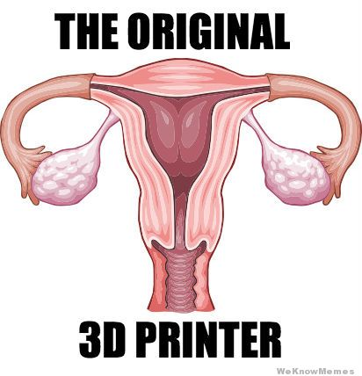
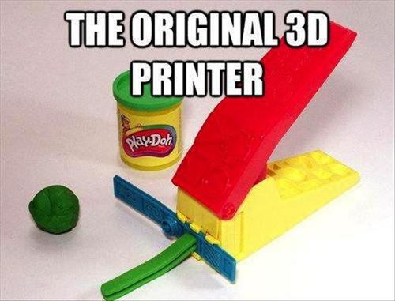
3D Printing – ‘’Origins’’
Brian Emerson, CART High School, Educating for Careers 2014

Slide 6
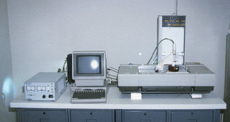
3D Printing - Origins
The Stereolithography Apparatus – 1984
Charles Hull – 3d Systems
Brian Emerson, CART High School, Educating for Careers 2014

Slide 7
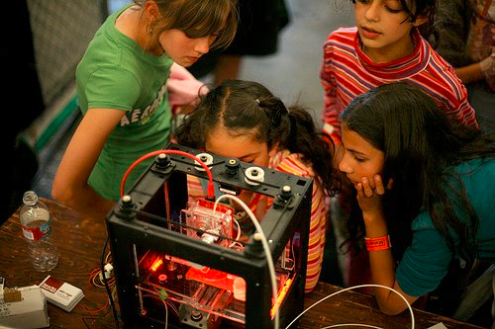
3D Printing – Today
Moving from Industry to Personal - Makers
Variety of materials
Plastics, Metals, Sandstone, Ceramic, Concrete, etc.
Multiple materials in tandem
Industry impact growing
NASA
Lego
Education
Brian Emerson, CART High School, Educating for Careers 2014

Slide 8
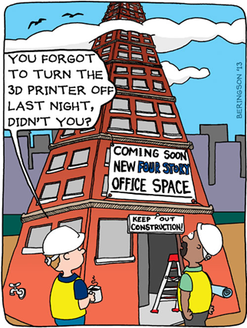
3D Printing – The Future
Houses
Brian Emerson, CART High School, Educating for Careers 2014

Slide 9
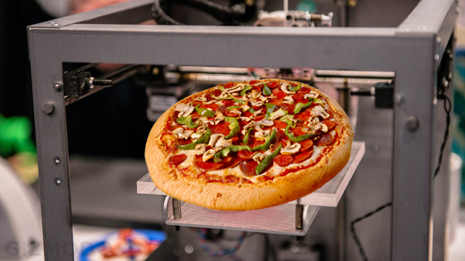
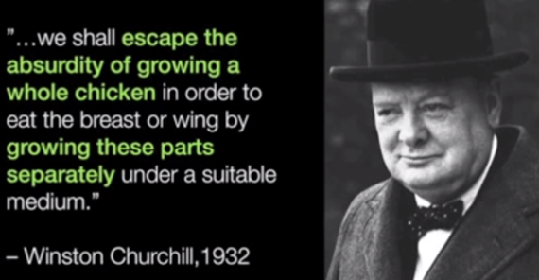
3D Printing – The Future
Houses
Food
Brian Emerson, CART High School, Educating for Careers 2014

Slide 10
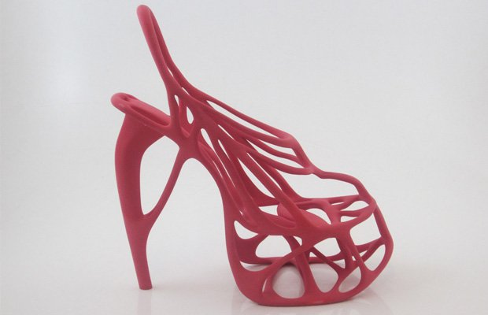
3D Printing – Today
Houses
Food
Clothing
Brian Emerson, CART High School, Educating for Careers 2014

Slide 11
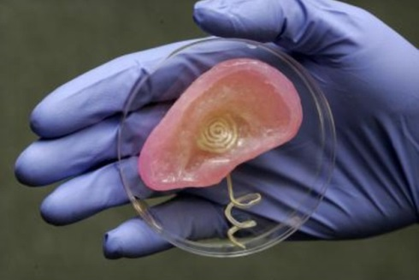
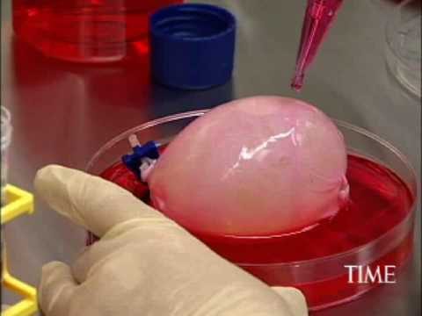
3D Printing – The Future
Houses
Food
Clothing
Human organs and body parts
Brian Emerson, CART High School, Educating for Careers 2014

Slide 12
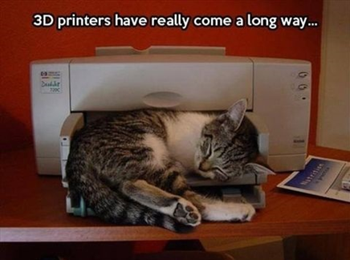
Innovation for Good
Brian Emerson, CART High School, Educating for Careers 2014

Slide 13
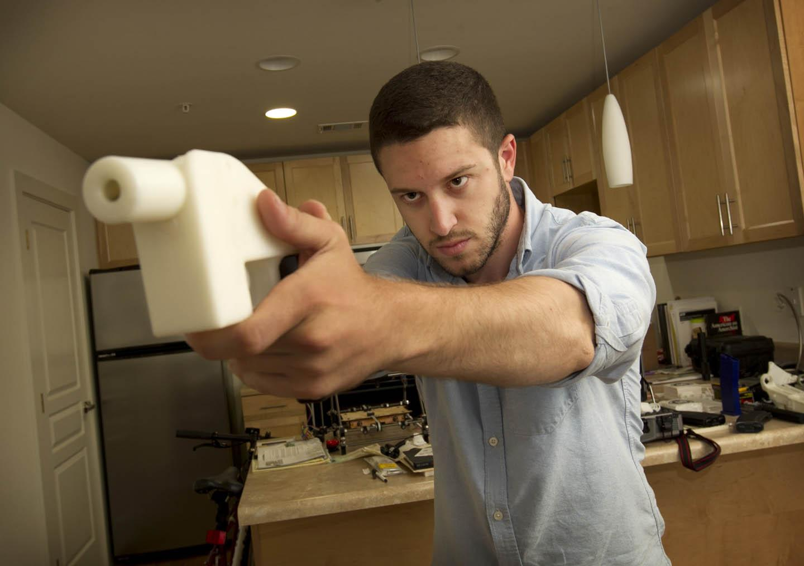
Or Otherwise…
Brian Emerson, CART High School, Educating for Careers 2014

Slide 14
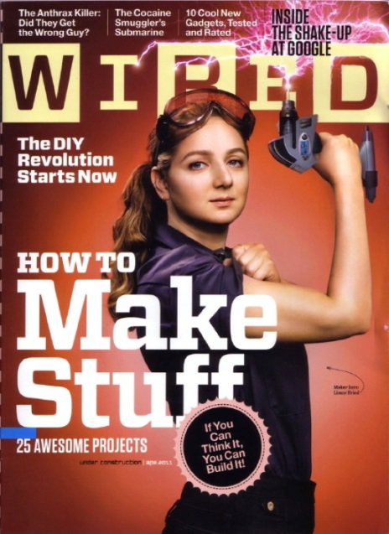
Show me the money!
Donorschoose.org
Crowd funding for schools
Free to post projects/needs
Zcorp.com
Lifehacker
NSF
Shapeways
Local Industry
Brian Emerson, CART High School, Educating for Careers 2014

Slide 15
Grant Ideas
Grant Ideas for 3D Printing
www.donorschoose.org
https://www.zcorp.com/en/Z-Corp/New-Grants---3D-Printer-Stimulus-Package-for-Schools/spage.aspx
http://lifehacker.com/how-to-get-started-with-3d-printing-without-spending-a-1340345210
http://www.nsf.gov/funding/index.jsp
http://www.shapeways.com/
Brian Emerson, CART High School, Educating for Careers 2014

Slide 16
Additional Information
More information on 3D Printing
http://3dprintingindustry.com/education/
http://3dprintingindustry.com/3dpitv/
http://www.3ders.org/
http://3dprintinginsider.com/
http://makezine.com/
Brian Emerson, CART High School, Educating for Careers 2014

Slide 17
CART Student Project
Wonder Belt
3 different labs from 3 different pathways
6 students from 5 different high schools
5 teachers and 1 patent attorney
1 business plan
Bringing ideas to life
Brian Emerson, CART High School, Educating for Careers 2014

Slide 18
Thanks to my Industry and Academic Partners
Grundfos
PELCO by Schneider Electric
Kustom Creation
Betts Co.
Project 321
Iscar Tooling
Fresno State University
Fresno County ROP
Brian Emerson, CART High School, Educating for Careers 2014

Slide 19
Questions?
Remember…
I am not an expert, but I know some
I am not a salesperson, but I know some
I am an educator, but I’m new
I appreciate your opinions, but I’m the messenger
I appreciate your feedback on Guidebook!
Brian Emerson, CART High School, Educating for Careers 2014

Slide 20
Sources of Information
http://gizmodo.com/how-doctors-are-printing-bones-eyes-noses-and-blood-1474983505
http://www.forbes.com/sites/stevenkotler/2013/11/26/how-3d-printing-is-about-to-radically-extend-the-limits-of-human-performance/
http://3dprintingindustry.com/education/
http://hbr.org/2013/03/3-d-printing-will-change-the-world/ar/1
http://www.forbes.com/sites/realspin/2014/01/17/3d-printers-will-soon-change-the-world-if-its-not-strangled-in-a-lawyered-up-world/
http://farmindustrynews.com/farm-equipment/3-d-printing-technology-impact-agriculture
http://www.aimseducation.edu/blog/how-3d-printing-will-reshape-healthcare/
http://www.extension.harvard.edu/hub/blog/andy-engelward-math-teaching-director/using-3d-printers-mathematics-lessons
http://www.extremetech.com/extreme/175562-major-patent-expiration-could-spark-a-second-3d-printing-revolution
Brian Emerson, CART High School, Educating for Careers 2014

Slide 21
Want a Copy of This?
Scan this thing, viola!
Brian Emerson, CART High School, Educating for Careers 2014

